Slide 1
Infographics Toolkit Prototype
Group SAS2
Ankita Pise
Jesseca Taylor
Nitish Pandey
Sharan Gopalan
Yashwanth Nallabothu

Slide 2
Supported Use Cases

Slide 3
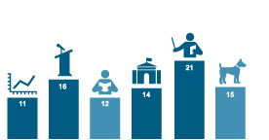
Connect Images to Chart
Notes:
connect images to a chart to add context

Slide 4
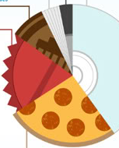
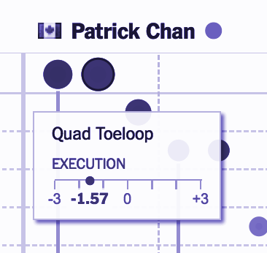
Replace Pie Slices with Images
Customized Images, Text, & Visualizations Tooltips
Notes:
add images to pie slices to make it more aesthetically pleasing and help differentiate and comprehend the slices better
Tooltip - to provide more information about the specific visualization

Slide 5
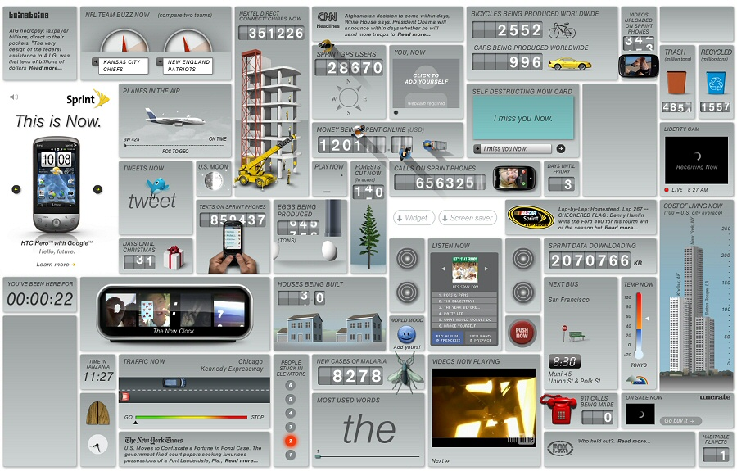
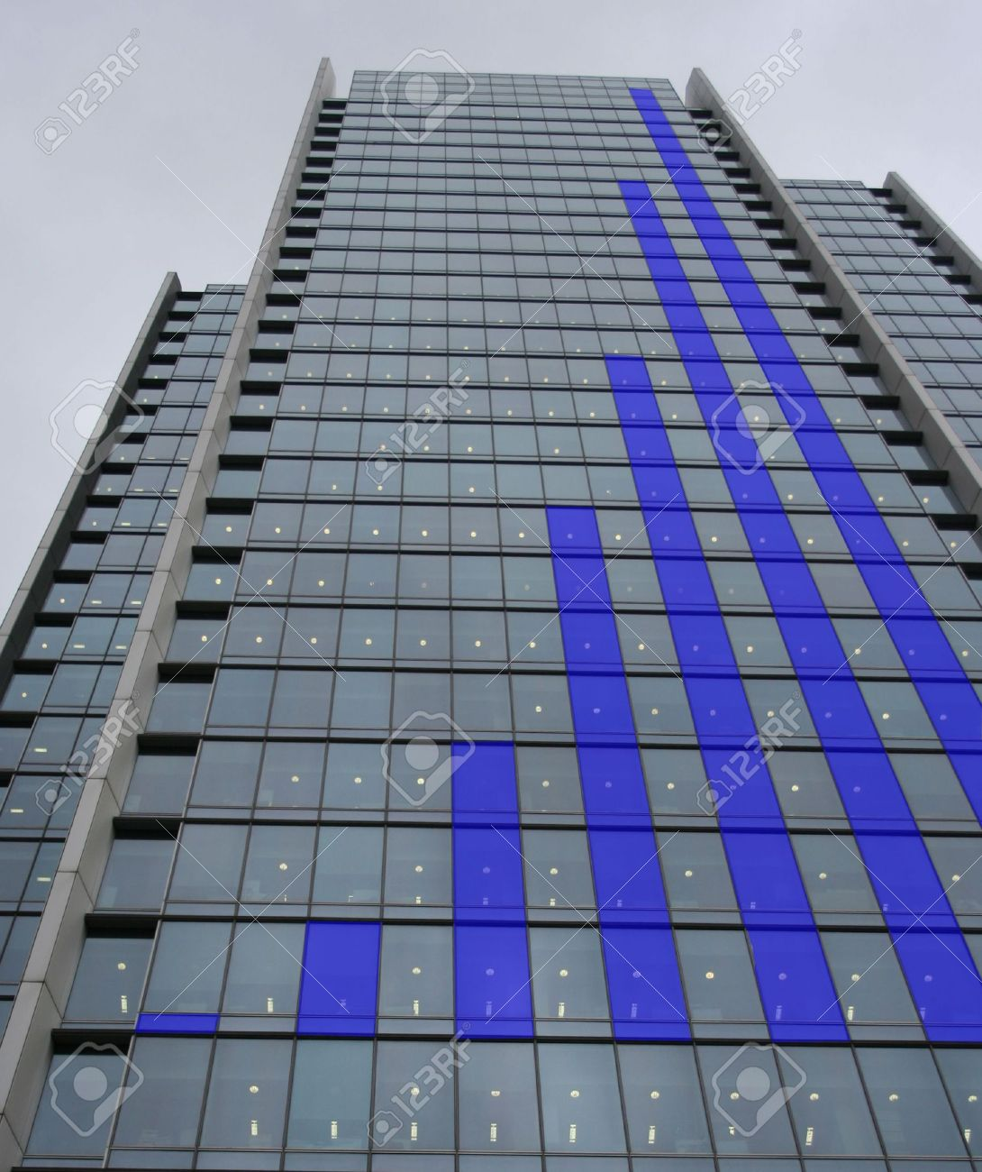
Attach Images to entire visualization
Use overlayed & masked images for decoration
Notes:
overlaying images to add context as well as for decorating
useful when there is a contextual overlap between the image and the visualization

Slide 6
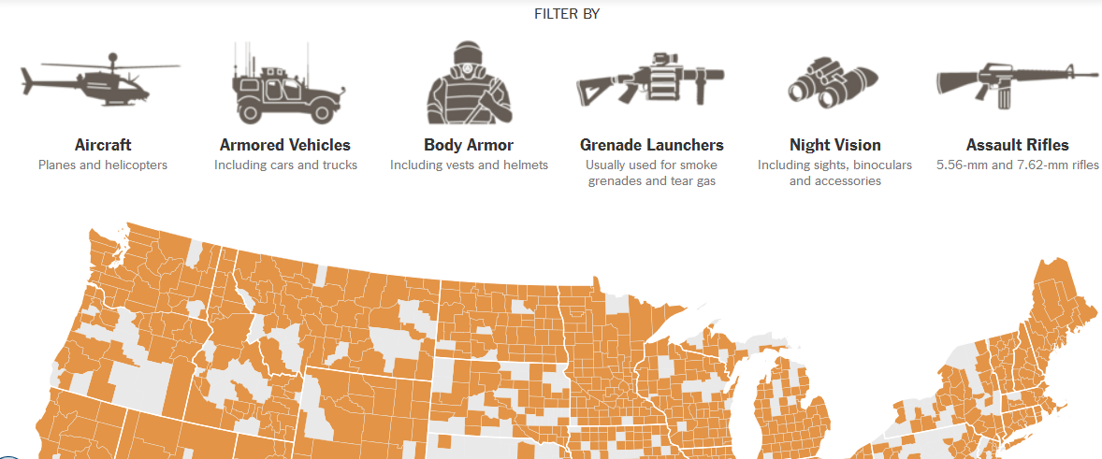
Images & Custom Content in Filtering Controls
Notes:
custom filter control scheme that gives various different visualizations that are contextually related to be shown together
Gives control to the user, makes it more engaging

Slide 7
Experiential Goals
Usefulness
Ease-of-use
Pleasantness
Attractiveness
Originality
Innovative
Notes:
usability and hedonic goals

Slide 8
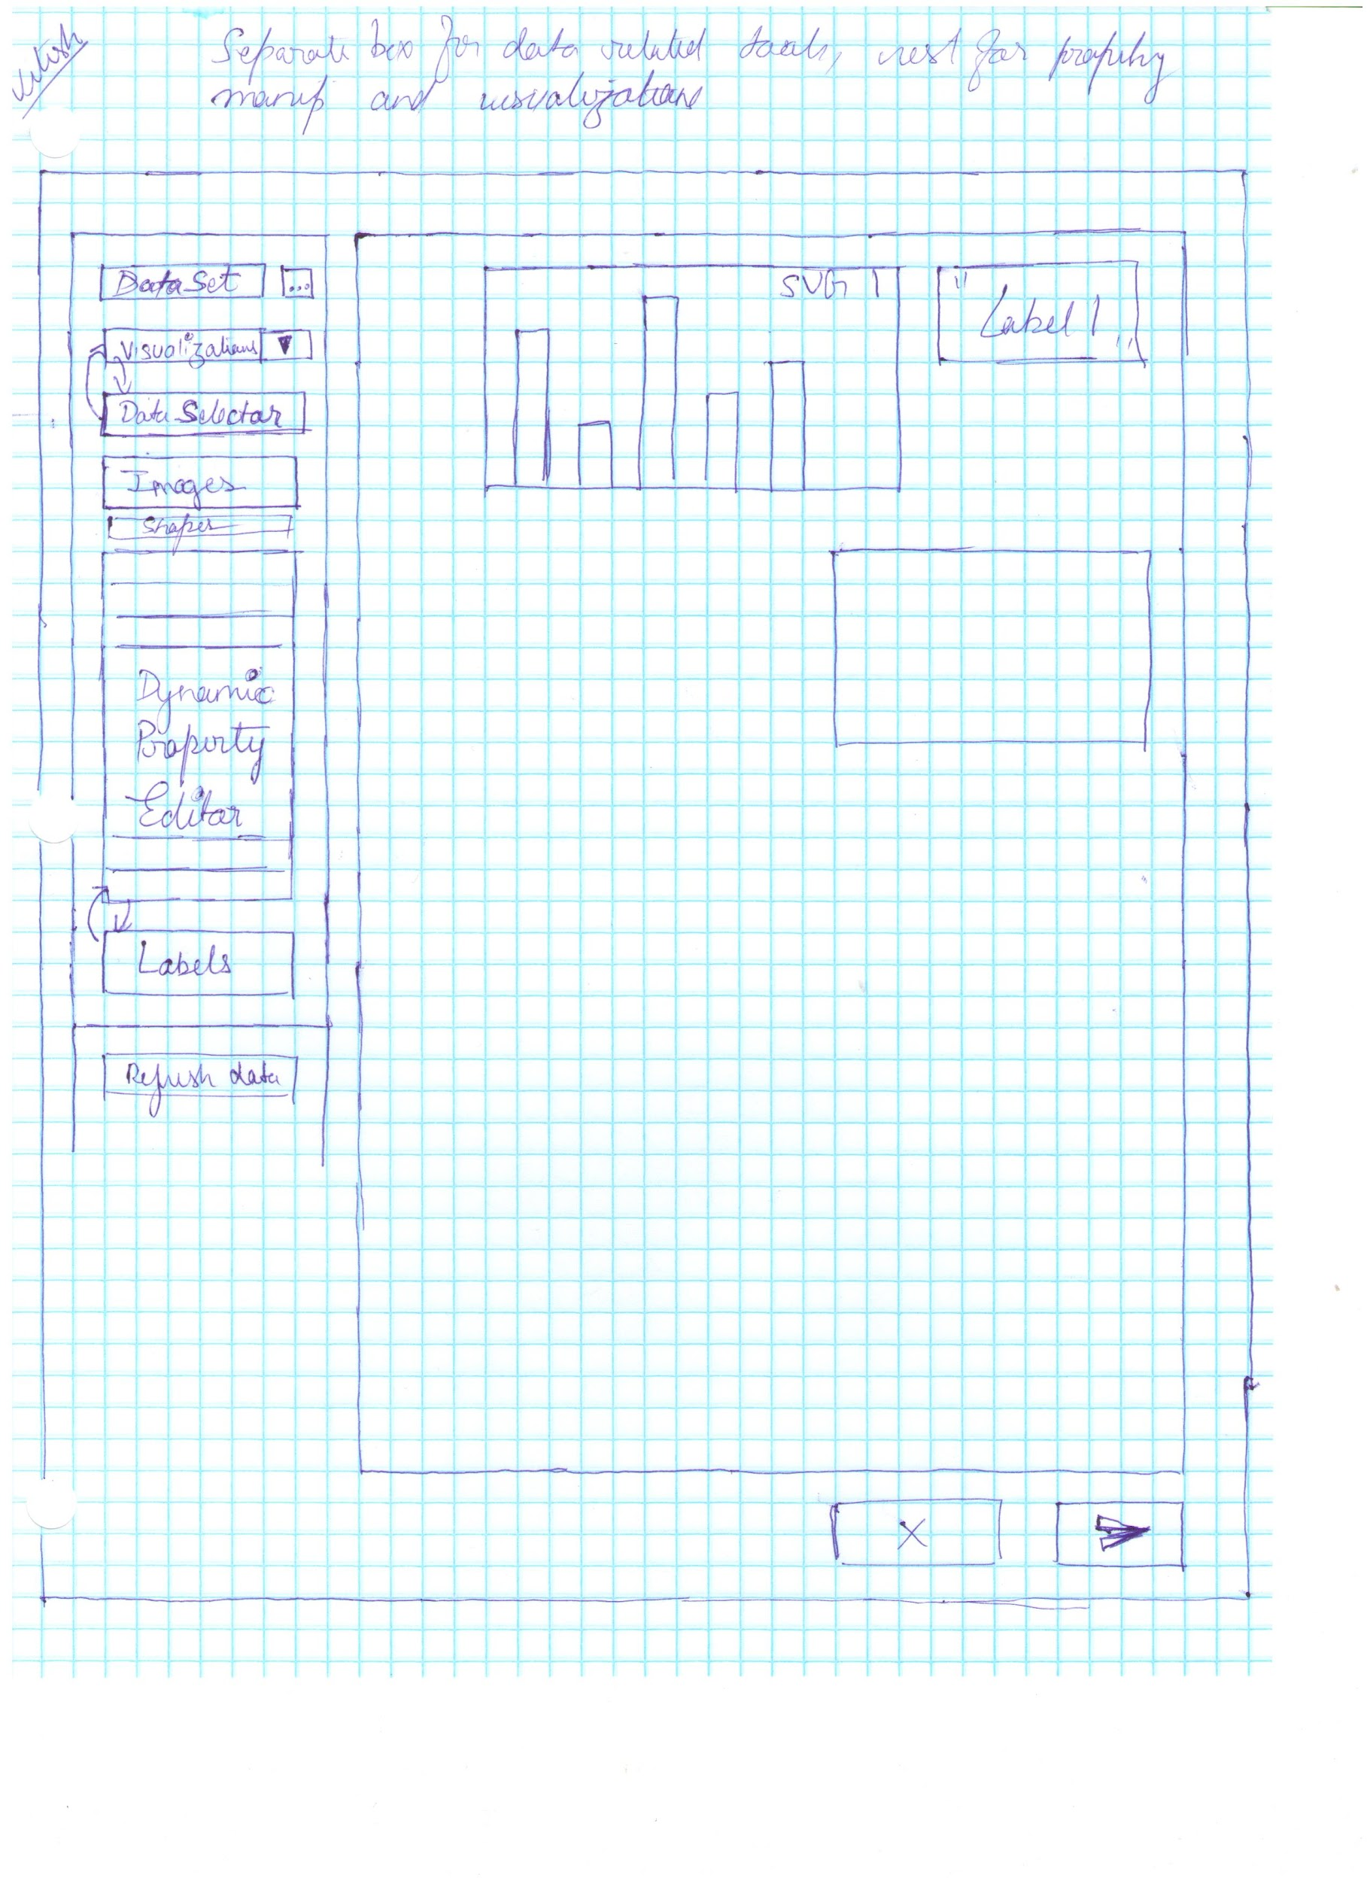
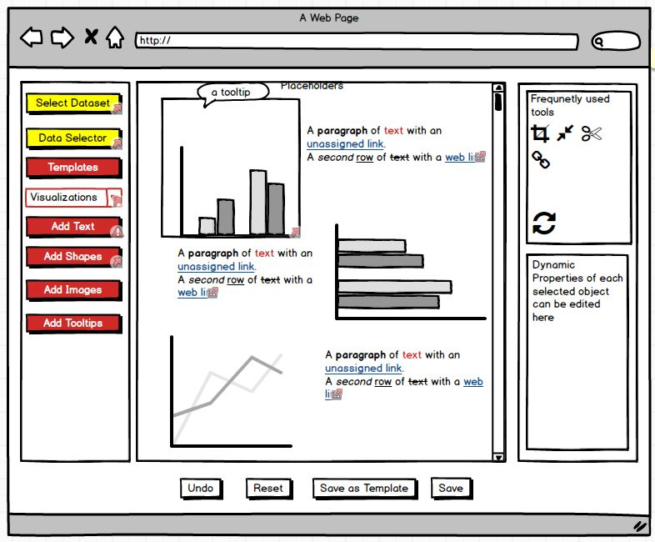
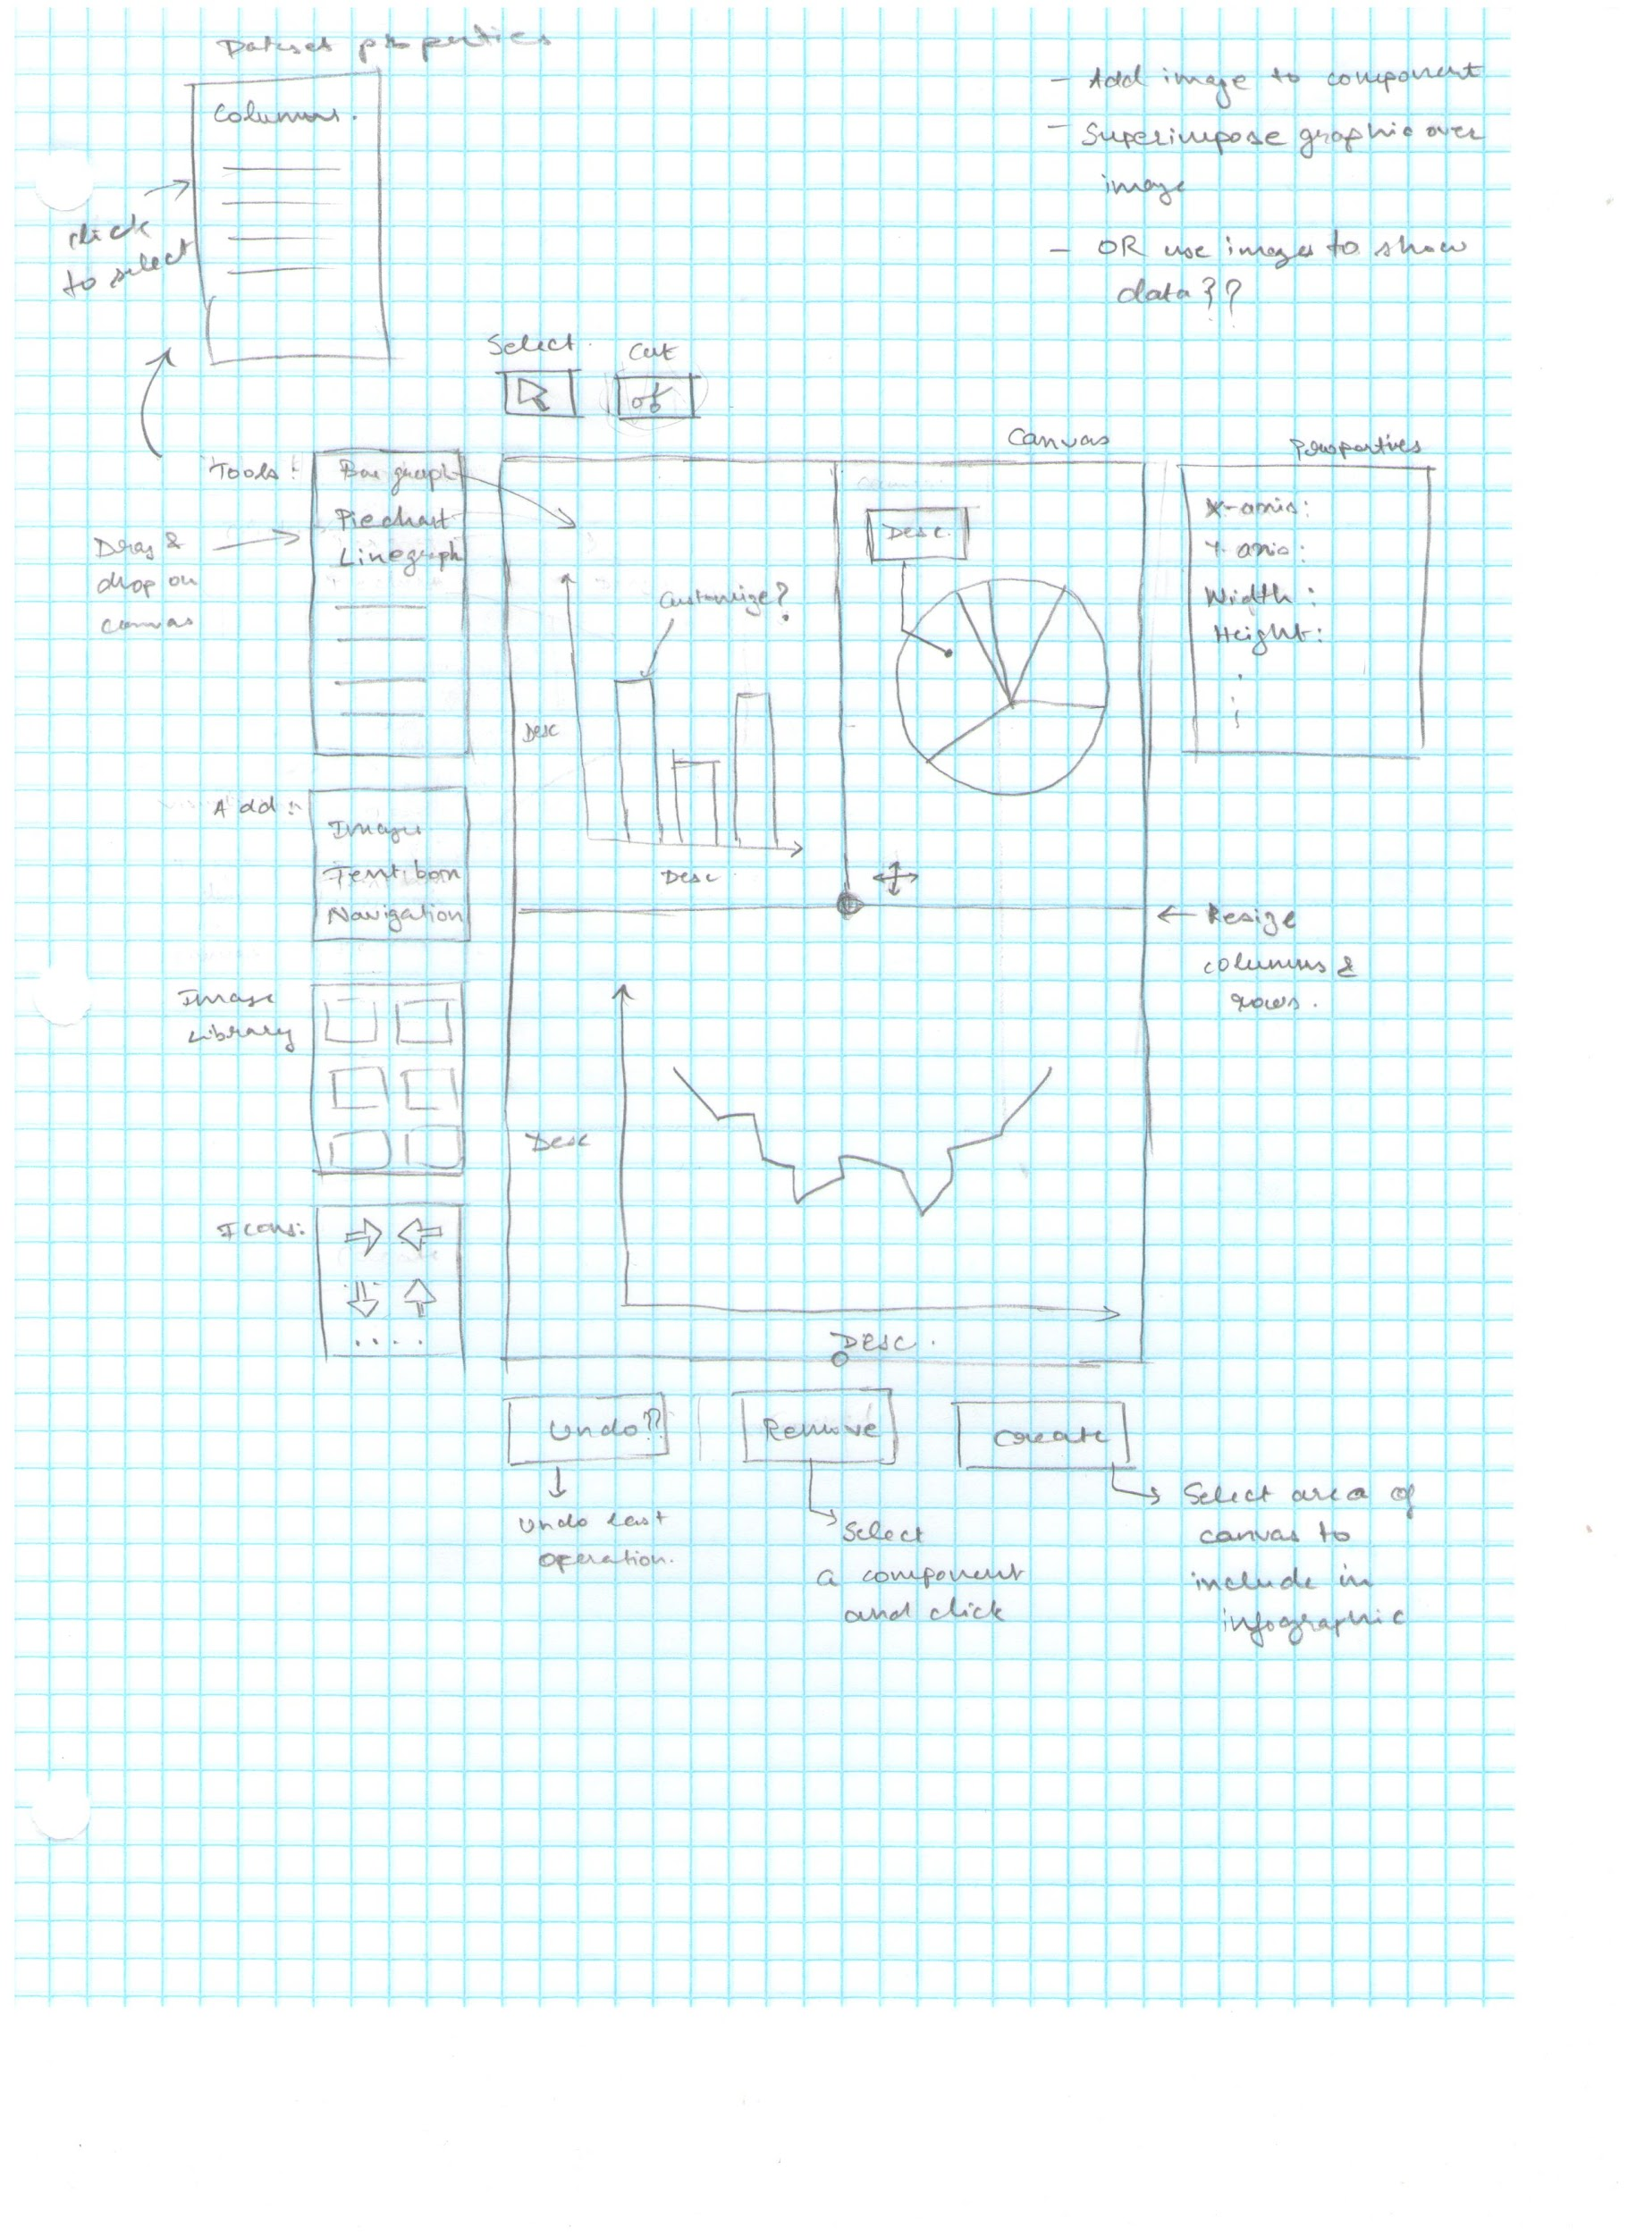
Early Work
Notes:
exploratory interviewing to gauge the

Slide 9
Formative Evaluation Results
Positives: Simple and Clean Layout
Needs Improvement: Tool Language

Slide 10
Final Low-Fidelity Prototype Demo

Slide 11
High Fidelity Prototype Demo

Slide 12
Evaluation Results
3 participants, varying in experience
Task-based evaluation
Between tasks
Single Ease Use (SEQ) question
Explanation of SEQ rating
Post-scenario
System Usability Scale (SUS)
Notes:
3 participants with difference experiences in data analysis and
Evaluation was task-based, they performed the tasks that Nitish mentioned during prototype walkthrough
Completed two questions after each task (Overall, this task was, rated on 7 pt scale from very difficult to very easy
Explained their rating
Completed the SUS at the end of session

Slide 13
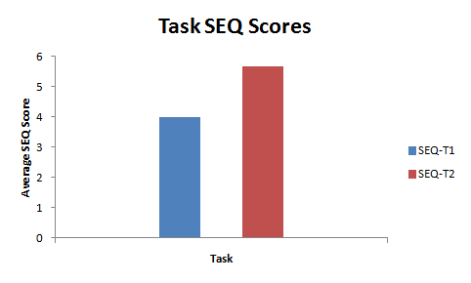
Evaluation Results
Positives
“Background was simple enough from add background button as well as text from add text button. Selecting certain columns from dataset was simple using dual box with add/remove arrows.”
Notes:
Bar chart on left shows the average ratings for the onboarding and visualizations tasks
Ratings were middle to high end of the scale
Here is a quote from a participant. Thought changing background, adding text, and selecting data ware easy

Slide 14
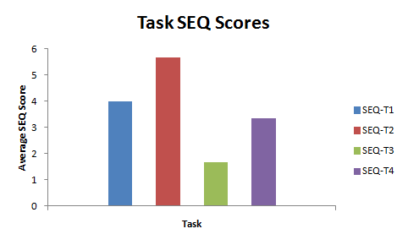
Evaluation Results
Needs Improvement
Restricted functionality with Balsamiq
Lack of transitions in Balsamiq
Solution
High fidelity prototype
More functionality
Direct manipulation
Notes:
Bar chart on right: the green and purple show tasks involving infographics and changing properties of infographics
2 aspects that negatively impacted ratings
Participants appeared frustrated that they couldn’t press certain controls and some transitions were not visible.
Balsamiq is limited in functionality like showing toggling between options
Solution to problem is use high fidelity prototype to allow users to use direct manipulation

Slide 15
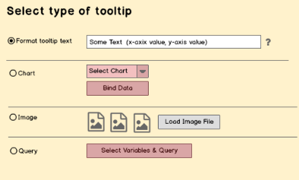

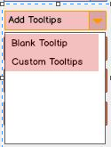
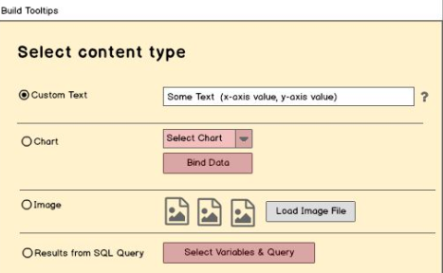
Improvements
Notes:
Another area was terminology in some functions, especially tooltips
This slide shows examples. Users didn’t know what quick add and the wizard meant; We updated the labels after the test
Same for the top option (shown on right and bottom option (query). We renamed them

Slide 16

Conclusion
Insights Gained
More design iterations
Fidelity of prototype matters
Notes:
We gain several insights during this project.
If we were to extend this project, we generate prototypes more quickly and evaluate often.
The fidelity of the prototype that is used is important. It really influences test participants opinions and performance.
Thank you allowing us to present our work. We hope you enjoyed our presentation. Thanks Dr. Watson and SAS team for giving us feedback through the course of this project!

